Slide 1
“MODERN PHYSICS” special theory of relativity
Noor Fatima
25F-CY-108

Slide 2
INTRODUCTION TO MODERN PHYSICS
Modern physics= physics beyond newton’s laws
It started in the early 20th century
It focuses on tiny particles (atoms,electrons,) and extremely fast objects.
“CLASSICAL PHYSICS WORKS FOR NORMAL SPEEDS AND BIG OBJECTS, BUT WHEN SCIENTISTS STUDIED ATOMS AND VERY HIGH SPEEDS,THEY SAW STRANGE RESULTS, TO EXPLAIN THIS MODERN PHYSICS WAS INTRODUCED”

Slide 3
DIFFERENCE BETWEEN CLASSICAL AND MODERN PHYSICS
Aspects | Classical physics | Modern physics
Time period | Before 19th century (newton,Maxwell) | 20th century to onwards (Einstein, plank, Bohr)
Main theories | Newton’s law of motion and Maxwell laws of electromagnetism | Theory of relativity and quantum mechanics
Accuracy | Works well in normal conditions | Needed in extreme conditions ( high speed, high energy)
Examples | Moving of cars, electricity and magnetism | Photoelectric effect and nuclear energy

Slide 4
SPECIAL THEORY OF RELATIVITY
INTRODUCTION
Proposed by Albert Einstein in 1909
Applied to objects moving with very high speeds
It deals with the problems in which one frame of reference moves with a Constant linear velocity relative to another frame of reference
It changed Concept of space and time.

Slide 5
POSTULATES OF SPECIAL THEORY OF RELATIVITY
POSTULATE 1 (Principle of reativity)
The laws of physics are samein all inertial frames of reference.
POSTULATE 2 (Constancy of the speed of light)
The speed of light in vacuum is always the same (3 × 10⁸ m/s).

Slide 6
KEY RESULTS
1. TIME DILATION
Moving clock ticks slower ( Astronaut age is slightly less than people on Earth)
2. LENGTH CONTRACTION
Moving clock ticks slower (Astronauts agr is slightly less than people on Earth.)
3. MASS VARIATION
The faster a rocket moves near light’s speed the heavier it becomes
More speed means more mass

Slide 7
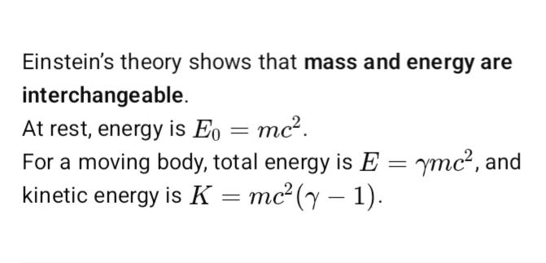
MASS ENERGY RELATIONSHIP

Slide 8
EXAMPLES AND APPLICATIONS
GPS needs relativity to stay accurate
NUCLEAR ENERGY works on E= mc^2
HIGH SPEED TRAVEL Time moves different for astronauts

Slide 9
CONCLUSION
Modern physics explain things that classical physics couldn’t
Special relativity proved that space and time are flexible
Today it helps us understand the universe, stars and technology
“EINSTEIN SHOWED US THAT THE UNIVERSE IS
NOT AS SIMPLE AS IT LOOKS. SPACE, TIME,
ENERGY AND MATTER ARE ALL CONNECTED”

Slide 10
THANK YOU
“MODERN PHYSICS IS NOT ONLY ABOUT THEORIES IT’S
THE FOUNDATION OF TODAY’S TECHNOLOGY “
Thank you all listening my presentation. I truly appreciate your time and attention

